Slide 1
Finding the Dynamic Characteristics of a sensor
Vidhya Balaji

Slide 2
Parameter Definition
Propagation Delay and Rise Time
Response Time
* ACS724KMA datasheet

Slide 3
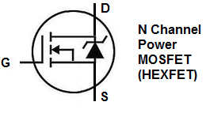



Block Diagram of Circuitry to produce sharp rise time signal
Gate Drive IC
Pulse generator
Output pulse with 1 µsec or less rise time
Power resistor
GND
Current In
Current Out
Sensor Output
Sensor DUT
GND

Slide 4
Settings and Parameters
V_{OUT} (V)
Output pulse from power MOSFET
Signal Generator
Pulse generated with rise time ~/< 1 µsec
Power MOSFET
Powered with VDD >=10V, IDD ~ 10A or higher for output pulse of significant magnitude
Preferably mounted on eval board with heat sink
Power resistor
< 1 ohm, >25 W for maximum current throughput: Current ~ Voltage/R
Smaller the R, greater the current
Oscilloscope
Sample mode of acquisition
HF reject
Common ground for all signals
Output pulse from sensor
Time (sec)

